Slide 1
FIN 654: FINANCIAL Analytics
SUPPLEMENT Week 4
Note: Code contained here is from a mix of sources as listed in References Slide(s)

Slide 2
Fixed income Securities
Bonds are like “tradeable loans”
Bond owner receives fixed stream of income
Income from bond is guaranteed at maturity
Bonds may be sold before maturity at market price
Market value of a bond fluctuates with interest
Bond prices and interest rates move in opposite directions
Long-term bonds are more sensitive to interest-rate changes
Coupon bonds make regular interest payments
Coupon rate for a bond is typically a half-year rate – example: 4% coupon rate = 8% annual
Zero-coupon bonds, a.k.a. pure discount bonds, pay no principal or interest until maturity
Yields, a.k.a. yield to maturity, is the average rate of return, including the loss (or gain) based on above (or below par) purchase of the bond
price > par → coupon rate > current yield > yield to maturity
price < par → coupon rate < current yield < yield to maturity
For a zero-coupon bond, PRICE = PAR(1 + r)^{-2T}

Slide 3
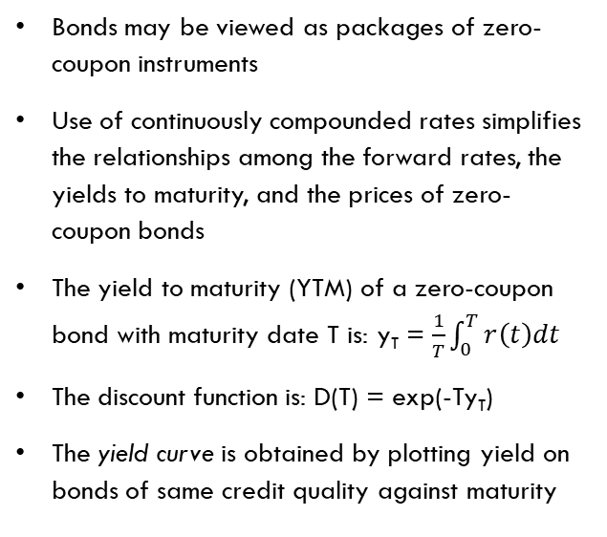
Term structure of Interest Rates
The term structure of interest rates represents how, at a given time, yield to maturity (YTM) depends on maturity
The term structure may be described by:
The prices of zero-coupon bonds of maturities 1-year, 2-years, … , n-years are denoted here by P(1), P(2), … , P(n)
spot rates (yields of maturity of zero-coupon bonds) of maturities 1-year, 2-years, …, n-years are denoted by y1, : : : , yn
forward rates r1, … , rn, where ri is the forward rate paid in the ith future year (i = 1 for next year, and so on)
Bonds may be viewed as packages of zero-coupon instruments
Use of continuously compounded rates simplifies the relationships among the forward rates, the yields to maturity, and the prices of zero-coupon bonds
The yield to maturity (YTM) of a zero-coupon bond with maturity date T is: y_{T} = $\frac{1}{T}\int_{0}^{T}{r\left(t\right)dt}$
The discount function is: D(T) = exp(-Ty_{T})
The yield curve is obtained by plotting yield on bonds of same credit quality against maturity

Slide 4
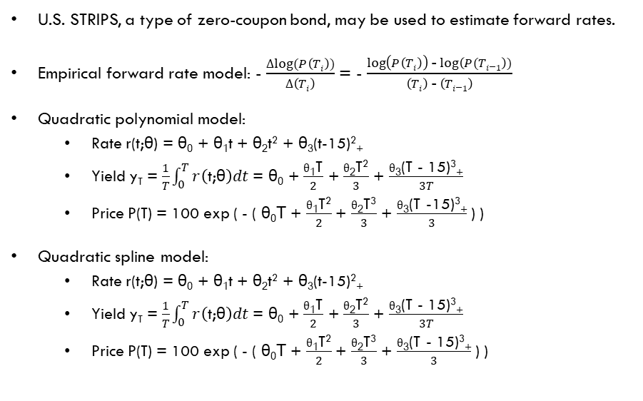
Modeling Forward Rates
U.S. STRIPS, a type of zero-coupon bond, may be used to estimate forward rates.
Empirical forward rate model: - $\frac{Δlog⁡(P\left(Ti\right))}{Δ\left(Ti\right)}$ = - $\frac{\log\left(P\left(Ti\right)\right) \text{-}\log\left(P(Ti\text{−}1\right))}{\left(Ti\right) \text{-} \left(Ti\text{−}1\right)}$
Quadratic polynomial model:
Rate r(t;θ) = θ₀ + θ₁t + θ₂t² + θ₃(t-15)²₊
Yield y_{T} = $\frac{1}{T}\int_{0}^{T}{r\left(\text{t}\text{;}\text{θ}\right)dt}$ = θ₀ + $\frac{θ\text{1}\text{T}}{2}$ + $\frac{θ\text{2}\text{T}\text{2}}{3}$ + $\frac{θ\text{3}\text{(}\text{T} \text{-} \text{1}\text{5)}\text{3}\text{+}}{3T}$
Price P(T) = 100 exp ( - ( θ₀T + $\frac{θ\text{1}\text{T}\text{2}}{2}$+ $\frac{θ\text{2}\text{T}\text{3}}{3}$ + $\frac{θ\text{3}\text{(}\text{T} \text{-}\text{15)}\text{3}\text{+}}{3}$ ) )
Quadratic spline model:
Rate r(t;θ) = θ₀ + θ₁t + θ₂t² + θ₃(t-15)²₊
Yield y_{T} = $\frac{1}{T}\int_{0}^{T}{r\left(\text{t}\text{;}\text{θ}\right)dt}$ = θ₀ + $\frac{θ\text{1}\text{T}}{2}$ + $\frac{θ\text{2}\text{T}\text{2}}{3}$ + $\frac{θ\text{3}\text{(}\text{T} \text{-} \text{15)}\text{3}\text{+}}{3T}$
Price P(T) = 100 exp ( - ( θ₀T + $\frac{θ\text{1}\text{T}\text{2}}{2}$+ $\frac{θ\text{2}\text{T}\text{3}}{3}$ + $\frac{θ\text{3}\text{(}\text{T}\text{ - }\text{15)}\text{3}\text{+}}{3}$ ) )
Note:
The spline with a knot at T = 15 splices two quadratic functions together at T = 15 so that the resulting curve is continuous and with a continuous first derivative
The positive-part function is x₊ = x if x >= 0 and x₊ = 0 if x < 0
x²₊ means (x₊)²
Notes:
STRIPS = “Separate Trading of Registered Interest and Principal of Securities“

Slide 5
Coding Nonlinear MODELS
## NLS - nonlinear (weighted) least-squares estimates of the parameters of a nonlinear model ##
dat = na.omit(read.table("data/strips_dec95.txt", header = TRUE))
t = seq(0, 30, length = 100)
emp = -diff(log(dat$price))/diff(dat$T)
fit.quad <- nls(price ~ 100 * exp(-theta_0 * T - (theta_1 * T^2)/2 - (theta_2 * T^3)/3), data = dat, start = list(theta_0 = 0.047, theta_1 = 0.0024, theta_2 = 0))
coef.quad <- summary(fit.quad)$coef[, 1]
forward.quad <- coef.quad[1] + (coef.quad[2] * t) + (coef.quad[3] * t^2)
fit.spline = nls(price ~ 100 * exp(-theta_0 * T - (theta_1 * T^2)/2 - (theta_2 * T^3)/3 - (T > 15) * (theta_3 * (T - 15)^3)/3),
data = dat, start = list(theta_0 = 0.047, theta_1 = 0.0024, theta_2 = 0, theta_3 = -7e-05))
coef.spline <- summary(fit.spline)$coef[, 1]
forward.spline <- coef.spline[1] + (coef.spline[2] * t) + (coef.spline[3] * t^2) + (t > 15) * (coef.spline[4] * (t - 15)^2)
plot(t, forward.spline, type = "l", lwd = 2, ylim = c(0.03, 0.075), xlab = "Maturity", ylab = "Forward Rate",
main = "US Treasury STRIPs Forward Curve: 1995")
lines(t, forward.quad, lty = 2, lwd = 2, col = "red")
points(dat$T[2:length(dat$T)], emp, pch = "*", cex = 1.5, col = "blue")
legend(x=1, y=.04, legend=c("Spline", "Quadratic", "Empirical"), col=c("black", "red", "blue"), lty=1:3, cex=0.8)

Slide 6
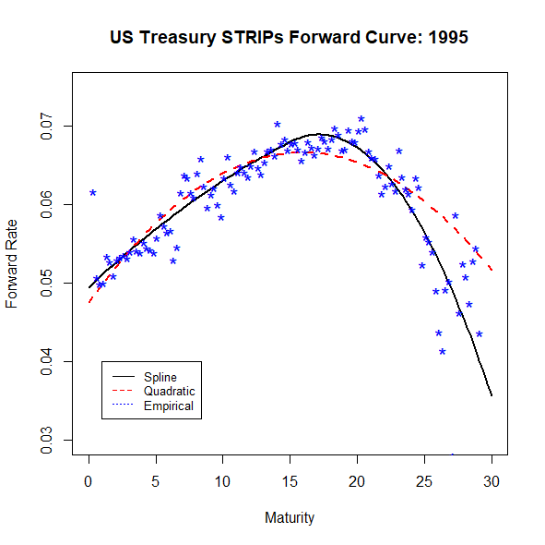
Quadratic Spline with One Knot
nls function implements nonlinear (weighted) least-squares estimates of the parameters of a nonlinear model
knot at T=15

Slide 7
Coding for Two Knots, 1 of 4
x.data <- na.omit(read.csv("data/termstr20170127.csv"))
x.data <- x.data[order(x.data$MATURITY),]
x.data$Tm <- x.data$MATURITY / 365 # express MATURITY in years
x.data <- x.data[, -2]
t <- x.data$Tm[-1] # seq(0,30,length = 100)
forward.emp <- -diff(log(x.data$PRICE))/diff(x.data$Tm)
forward.emp.df <- data.frame(t = t, forward.emp = forward.emp)
require(quantreg)
fit.quad <- nls(PRICE ~ 100*exp(-theta_0*Tm - (theta_1*Tm^2)/2 - (theta_2*Tm^3)/3),
data = x.data, start = list(theta_0=.01, theta_1=0.0024, theta_2=-0.0001))
fit.spline <- nls(PRICE ~ 100*exp(-theta_0*Tm
- (theta_1*Tm^2)/2 - (theta_2*Tm^3)/3 - (Tm<8)*(theta_3*(Tm-8)^3)/3 - (Tm>25)*(theta_4*(Tm-25)^3)/3 ),
data = x.data, start = list(theta_0=.01, theta_1=0.0024, theta_2=-0.0001, theta_3=0.00001, theta_4=0.0001))

Slide 8
Coding for Two Knots, 2 of 4
taus <- c(0.05, 0.50, 0.75)
fit.spline.q.05 <- nlrq(PRICE ~ 100*exp(-theta_0*Tm - (theta_1*Tm^2)/2 - (theta_2*Tm^3)/3
- (Tm<8)*(theta_3*(Tm-8)^3)/3 - (Tm>25)*(theta_4*(Tm-25)^3)/3 ), data = x.data, tau = taus[1],
start = list(theta_0=.01, theta_1=0.0024, theta_2=-0.0001, theta_3=0.00001, theta_4=0.0001))
fit.spline.q.50 <- nlrq(PRICE ~ 100*exp(-theta_0*Tm - (theta_1*Tm^2)/2 - (theta_2*Tm^3)/3
- (Tm<8)*(theta_3*(Tm-8)^3)/3- (Tm>25)*(theta_4*(Tm-25)^3)/3 ), data = x.data, tau = taus[2],
start = list(theta_0=.01, theta_1=0.0024, theta_2=-0.0001, theta_3=0.00001, theta_4=0.0001))
fit.spline.q.75 <- nlrq(PRICE ~ 100*exp(-theta_0*Tm - (theta_1*Tm^2)/2 - (theta_2*Tm^3)/3
- (Tm<8)*(theta_3*(Tm-8)^3)/3- (Tm>25)*(theta_4*(Tm-25)^3)/3 ), data = x.data, tau = taus[3],
start = list(theta_0=.01, theta_1=0.0024, theta_2=-0.0001, theta_3=0.00001, theta_4=0.0001))

Slide 9
Coding for Two Knots, 3 of 4
coef.spline <- summary(fit.spline)$coef[,1]
forward.spline <- coef.spline[1] + coef.spline[2]*t + coef.spline[3]*t^2
+ (t < 8)*coef.spline[4]*(t-8)^2 + (t > 25)*coef.spline[5]*(t-25)^2
coef.spline <- summary(fit.spline.q.05)$coef[,1]
forward.spline.q.05 <- coef.spline[1] + coef.spline[2]*t + coef.spline[3]*t^2
+ (t < 8)*coef.spline[4]*(t-8)^2 + (t > 25)*coef.spline[5]*(t-25)^2
coef.spline <- summary(fit.spline.q.50)$coef[,1]
forward.spline.q.50 <- coef.spline[1] + coef.spline[2]*t + coef.spline[3]*t^2
+ (t < 8)*coef.spline[4]*(t-8)^2 + (t > 25)*coef.spline[5]*(t-25)^2
coef.spline <- summary(fit.spline.q.75)$coef[,1]
forward.spline.q.75 <- coef.spline[1] + coef.spline[2]*t + coef.spline[3]*t^2
+ (t < 8)*coef.spline[4]*(t-8)^2 + (t > 25)*coef.spline[5]*(t-25)^2
coef.quad <- summary(fit.quad)$coef[,1]
forward.quad <- coef.spline[1] + coef.spline[2]*t + coef.spline[3]*t^2

Slide 10
Coding for Two Knots, 4 of 4
require(ggplot2)
x.spl <- data.frame(t = t, forward.spline = forward.spline, forward.spline.q.05 = forward.spline.q.05,
forward.spline.q.50 = forward.spline.q.50, forward.spline.q.75 = forward.spline.q.75,
forward.quad = forward.quad, forward.emp = forward.emp)
plot(1:100, 1:100, type="b", pch=19, col="red", xlab="x", ylab="y") ## dummy plot for legend to work
ggplot(data = x.spl, aes(x = t, y = forward.spline)) + geom_line(colour = "black") +
geom_line(aes(x = t, y = forward.quad), colour = "red", linetype = "dashed") +
geom_line(aes(x = t, y = forward.spline.q.05), colour = "darkgreen", linetype = "dashed") +
geom_line(aes(x = t, y = forward.spline.q.50), colour = "darkorange", linetype = "dashed") +
geom_line(aes(x = t, y = forward.spline.q.75), colour = "darkmagenta", linetype = "dashed") +
geom_point(aes(x = t, y = forward.emp), col="blue") +
ylim(0.01, 0.05) + xlim(min(t), max(t)) + ggtitle("Maturities 0-30 years")
legend(x=59, y=21, legend=c("Spline", "Quadratic", "Quantile .05", "Quantile .50", "Quantile .75", "Empirical"),
col=c("black", "red", "darkgreen", "darkorange", "darkmagenta", "blue"), lty=c(1,2,2,2,2,3), cex=0.8)

Slide 11
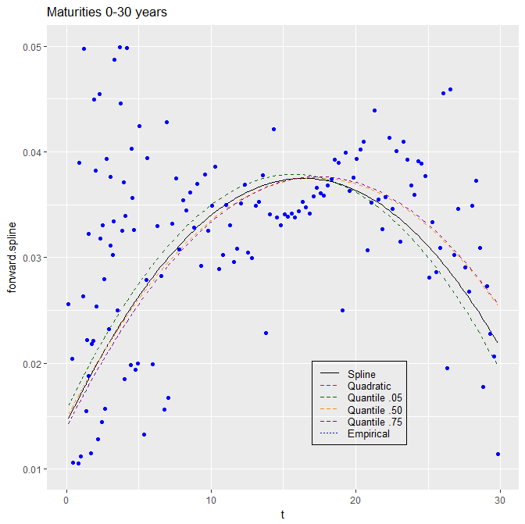
Quantile Splines with two Knots
nlrq - function implements nonlinear quantile regression - the algorithm is based on interior point ideas - Koenker & Park (1994)
knots at T=8 and T=25
quantile_taus <- c(0.05, 0.50, 0.75)

Slide 12
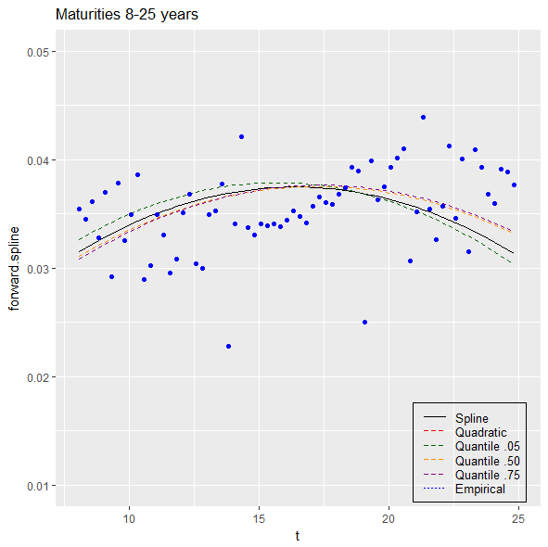
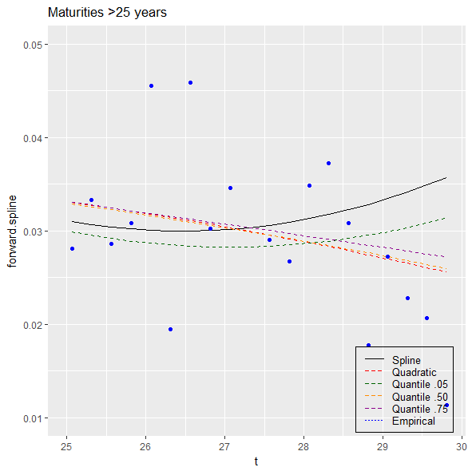
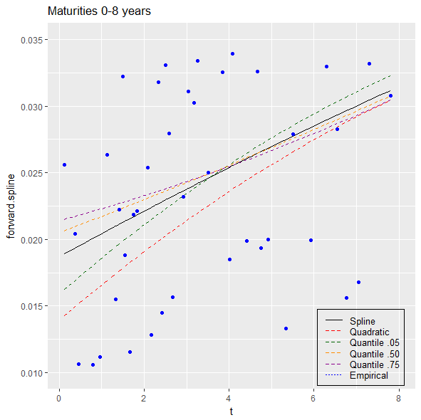
Quantile Splines, Piece by Piece
Piecewise plotting of Quantile Splines spliced at the knots
knots at T=8 and T=25
quantile_taus <- c(0.05, 0.50, 0.75)

Slide 13
Reference books
Bennet and Hugen. 2016. Financial Analytics with R: Cambridge Univ Press.
Paul Teetor. 2011. R Cookbook. O’Reilly: Sebastopol, CA.
Phil Spector. Data Manipulation with R.
Norman Matloff. The Art of R Programming: A Tour of Statistical Software Design.
John Taveras. R for Excel Users at https://www.rforexcelusers.com/book/.
Winston Chang. 2014. R Graphics Cookbook. O’Reilly: Sebastopol, CA.

Slide 14
Reference links
http://www.cookbook-r.com/
https://books.google.com/books?id=fxL4tu5bzAAC&printsec=frontcover
https://www.datacamp.com/courses/free-introduction-to-r
http://www.r-tutor.com/r-introduction/
https://www.statmethods.net/
https://livebook.manning.com/#!/book/r-in-action-second-edition/
https://blog.rstudio.com/2015/06/24/leaflet-interactive-web-maps-with-r/
https://www.analyticsvidhya.com/blog/2015/07/guide-data-visualization-r/
https://jabranham.com/blog/2015/09/rmarkdown-vs-latex/
https://www.revolvy.com/main/index.php?s=YAML

Slide 15
Data Sources
https://finance.google.com/finance
https://finance.yahoo.com/quote/<sym>/history?ltr=1 ## <sym> is ticker symbol
https://fred.stlouisfed.org/categories
https://www.eia.gov/<energy>/data.php ## <energy> is petroleum, naturalgas, electricity, etc.
https://www.indexmundi.com/commodities/
https://www.lme.com/en-GB/Market-Data
https://www.oanda.com/forex-trading/analysis/economic-indicators/united-states
https://www.quandl.com/search?query=
https://www.treasurydirect.gov/govt/reports/pd/mspd/mspd.htm
http://www.wsj.com/mdc/public/page/2_3020-tstrips.html

